Slide 1
Robotic Navigation and Vision

Slide 3
Notes:
Welcome to QUT Gardens Point Campus. You’re in the Science and Engineering Centre today , home of The Cube, one of the largest digital learning and display spaces in world.
Ambassador Introductions:
Name
Degree and year you’re in
Add something else about your degree or what you love about QUT
Point out where the toilets and bubblers are. Remind students to let their teacher know if they are leaving the room.
The door is alarmed and will the alarm will sound if the door is left open or not closed properly so please be sure to close it properly behind you.
In the unlikely event of an emergency, an alert sound will be heard. (Intermittent tone) This means be prepared to evacuate. If we need to evacuate the sound will change and there’ll be a verbal message. If this happens, stay calm, stay together as a group and follow us downstairs to the kidney lawn (point it out).

Slide 4
The Task
You've been tasked to give a rover stranded on mars the means to navigate back to it's extraction point.
Markers have been dropped in the environment in the eight major directions. The extraction point is at the center of these markers.

Slide 5
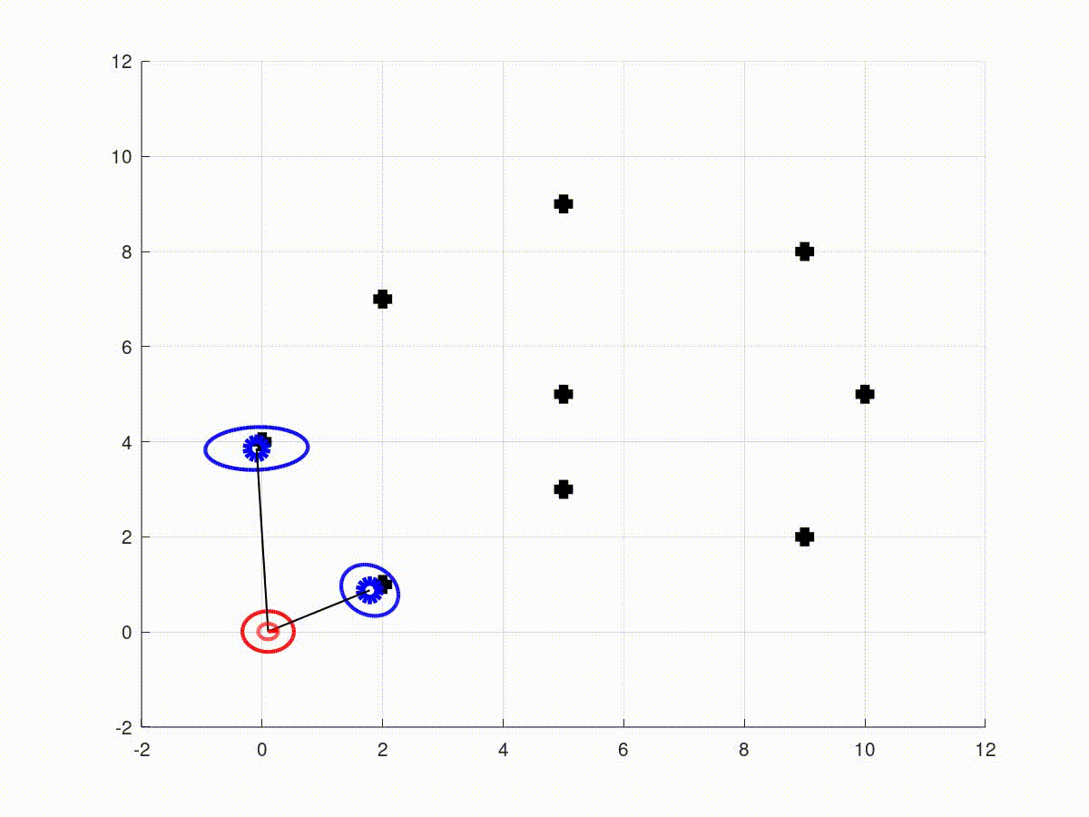
Introducing SLAM
SLAM or Simultaneous Localisation and Mapping.
Using Kalman Filter the robot views the world as a set of probabilities because it is never 100% sure of it's information.

Slide 6
Steps
1. Prediction
- Using internal sensors to guess how much the robot has moved
2. Update
- Using sensors to update our assumptions about ourselves and our environment
3. Control
SLAM Simplified
- Simplified using a known map
- Map Assisted Localisation and Navigation

Slide 7
MATLAB Refresher

Slide 8
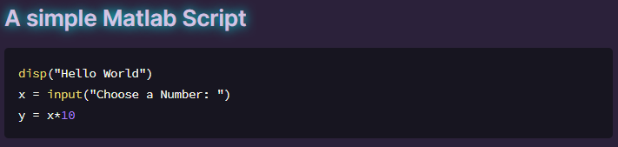
Our First MATLAB Script

Slide 9
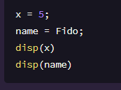
Variables

Slide 10
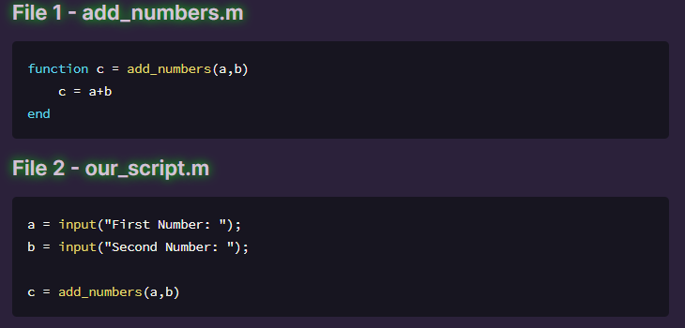
Functions

Slide 11
Putting our code together

Slide 12
Setup
Open Skeleton file on computer
Have a look through

Slide 13
Prediction
**Have you ever tried walking with your eyes closed?**
- Robots 2 ways of viewing the world
- Internal sensors (Encoders, Gyroscopes, Accelerometers)
- External sensors (GPS, cameras, LIDARS)
The prediction step uses the internal sensors of the robot, in our case the motor encoders, to take a guess at where it is.

Slide 14
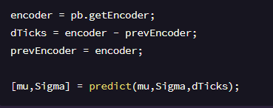
Prediction Code

Slide 15
Update
Walking with your eyes open.
External sensors - Vision
Using AprilTags as landmarks

Slide 16
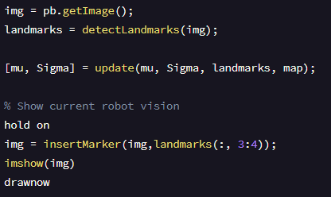
Update Code

Slide 17
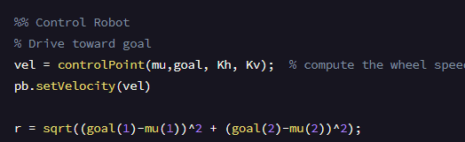
Control Code

